Slide 1
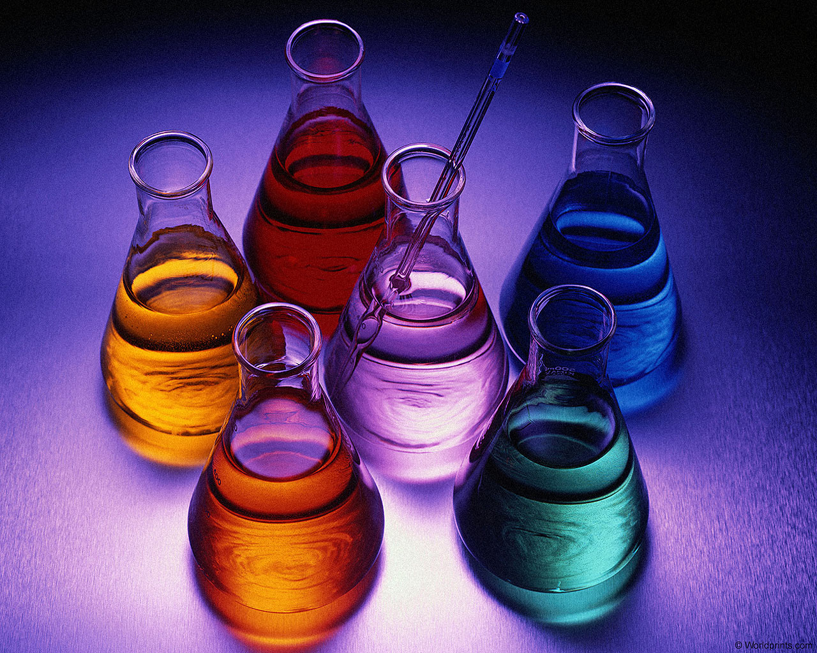
Physical And Chemical Properties

Slide 2
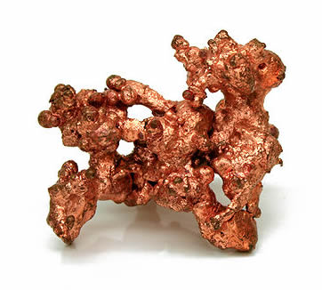
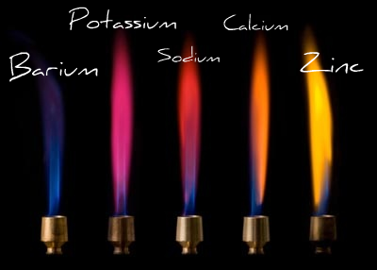
Properties
Properties are descriptions of matter.
There are 2 types of properties…

Slide 3
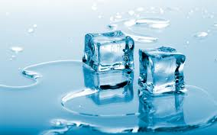
Physical Properties
Identified easily. It is what it is. NO CHANGE to chemical structure.
Color (red, yellow, etc.)
State (solid, liquid, or gas)
Odor (odorless, smells like eggs, etc.)
Hardness (hard, soft, squishy)
Density (amount of mass in a given amount of space)
Volume (amount of space an object occupies)
Freezing Point
Boiling Point

Slide 4
Physical Properties
List 3 Physical Properties of the following objects:

Slide 5
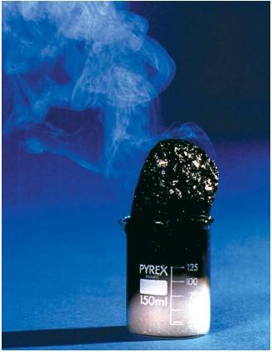
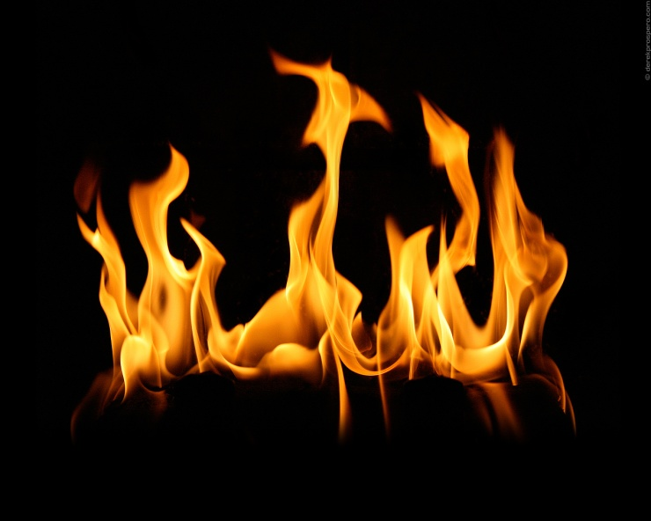
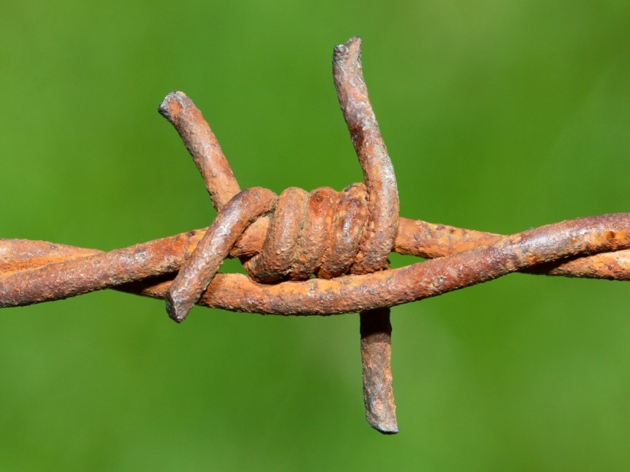
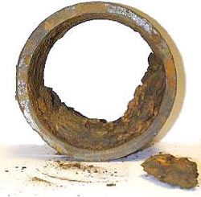
Chemical Properties
Identified only by CHANGING the substance’s chemical identity.
1. Flammable/Nonflammable
2. Combustible/Noncombustible
(burns or doesn’t burn)
3. Corrosive/Noncorrosive
(can be destroyed slowly by chemical action)
4. Rusts/Does not rust
5. Reactivity

Slide 6
Reactivity
Different substances react differently to other substances. If two substances REACT chemically to each other, we say the substance has reactivity to that substance.
Sodium metal is reactive to water!!

Slide 7
Indentify the following as either a physical or chemical property of paper
Burns yellow
Chemical
Wrinkled
Physical
Rectangle
Physical
Reacts with light
Chemical
Thin
Physical
White
Physical
Flammable
Chemical

